Slide 1
Capstone Project –The Battle of neighbourhoods- Presentation
Rupali Khapre

Slide 2
Introduction
Background : Safety is a top concern when moving to new area. If you don’t feel in your home, you’re not going to be enjoy living there.
Problem: This project aims to select the safest borough in London based on the total crimes, explore the neighbourhood of that borough to find the 10 most common venues in each neighbourhood and finally cluster the neighbourhoods using K-Means.
Interests: Expats who are considering to relocate to London will be interested to identify the safest borough in London and explores its neighbourhood and common venues around the each neighbourhood.

Slide 3
Data Acquisition and cleaning
Data Acquisition : The data acquired for this project is a combination of data from three sources :
The first data source of the project uses London crime data that shows the crime per borough in London.
The second source of data is scrapped from a Wikipedia page that contains the list of London borough . This page contains additional information about the borough.
The third data source is the list of the neighbourhoods in the Royal Borough of Kingston upon Thames as found on the Wikipedia page.

Slide 4
Methodology
Data cleaning : the data cleaning process for each of the three sources of data are done separately.
From the London crime data , the crimes during the most recent year (2016) are only selected. The major categories of crime are pivoted to get the total crimes per the borough for each major category.
The second data is scrapped from a Wikipedia page using the Beautiful Soup library in python. Using this library we can extract the data in the tabular format as shown in the websites.
The two datasets are merged on the Borough names from a new dataset . The purpose of this data set is to visualise the crime rates in each borough and identify the borough with the least crime recorded during the year 2016.
After the visualizing the crime in each borough we can find the borough with the lowest crime rate. The third dataset is created , with the names of the neighbourhoods and the names of the borough with the latitude and longitude obtained using Google Maps API geocoding.
The new data set is used to generate 10 most common venues for each neighbourhood using FourSquare API, finally using k means clustering algorithm to cluster similar neighbourhood together.

Slide 5
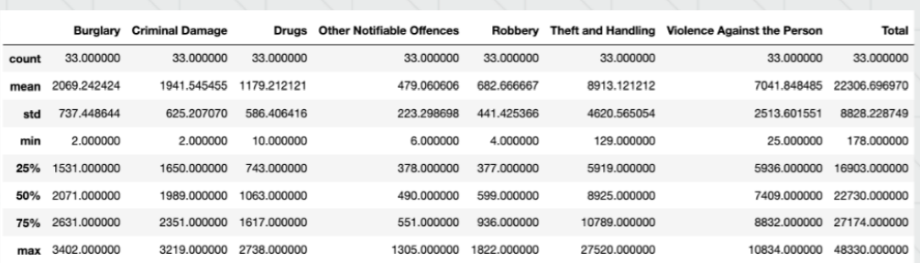
Methodology
Exploratory Data Analysis :
Statistical summary of crimes
The count for each of the major categories of crime returns the value 33 which is the number of London borough . ‘Theft and Handling ‘ is the highest reported crime during 2016 followed
by ‘Violence against the person’, ‘Criminal damage’. The lowest recorded crimes are ‘Drug', 'Robbery’ and ‘Other Notifiable offenses’.

Slide 6
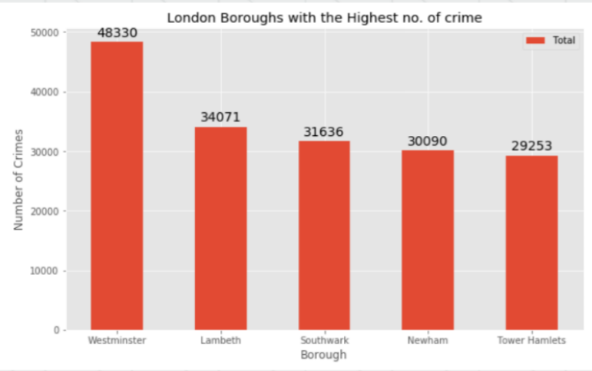
Boroughs with the highest crime rates
Comparing five borough with the highest crime rate during 2016 it is evident that Westminster has the highest crimes recorded followed by Lambeth , Southwark, Newham and Tower Hamlets. Westminster has a significant higher crime rate than the other 4 borough.

Slide 7
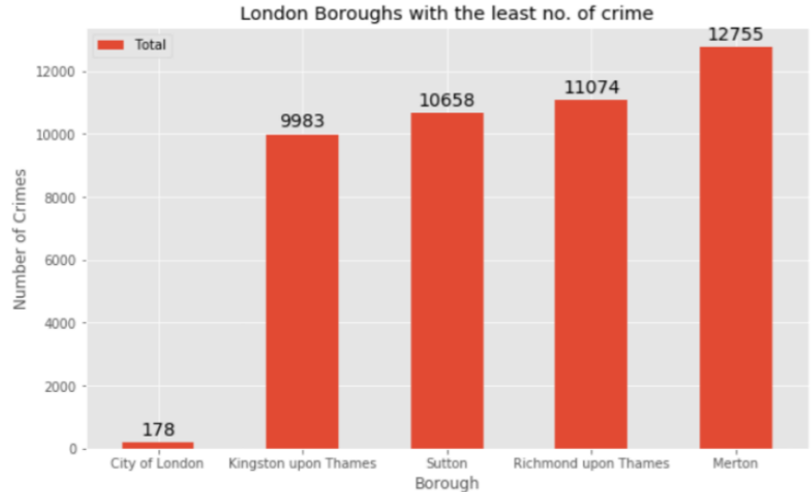
Boroughs with the lowest crime rates.
Comparing five borough with the lowest crime rate during the year 2016 , City of London has the lowest recorded crimes followed by Kingston upon Thames , Sutton , Richmond upon Thames and Merton.
City of London has a significantly lower crime rate because it is the 33rd principal division of Greater London but it is not a London borough. It has an area o 1.12 square miles and population of 7000 as of 2013 which suggests that it is small area.
We will consider the next borough with the lowest crime rates is the safest borough in London which Kingston upon Thames.

Slide 8
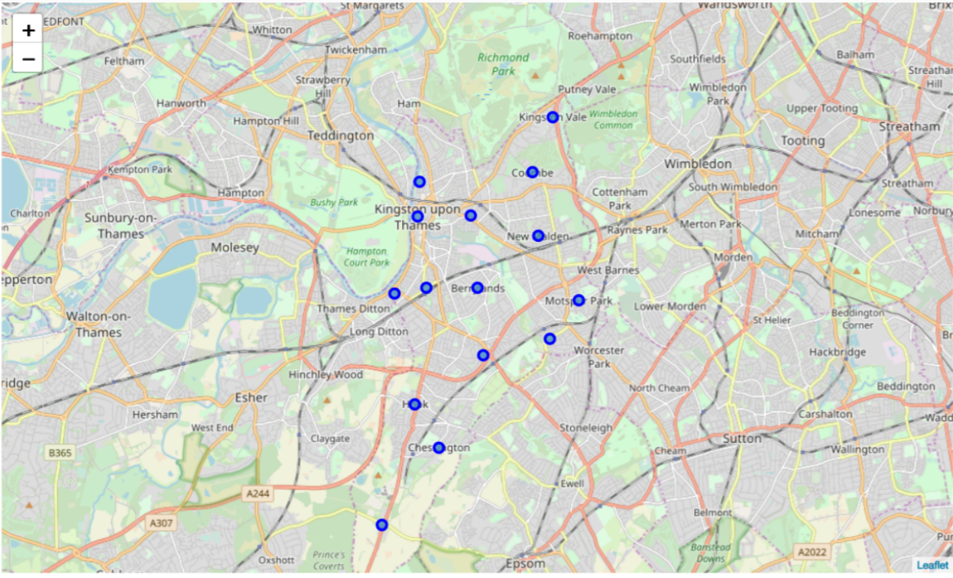
Neighboorhoods in Kingston upon Thames
There are 15 neighbourhoods in the royal borough of Kingston upon Thames, they are visualised on a map using folium on python.

Slide 9
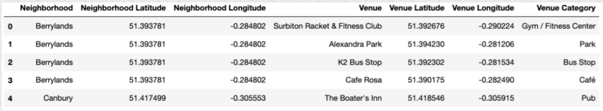
Modelling
Using the final data set containing the neighbourhood of the Kingston upon Thames along with the latitude and longitude , we can find all the venues with 500 meters radius each neighbourhood by connect Four square API.
One hot encoding is done on the venues data . The venues data is the grouped by the neighbourhood and the mean of the venues are calculated , finally the 10 common venues are calculated for each of the neighbours .
To help people to find the similar neighbourhoods in the safest borough we will be clustering similar neighbourhoods using K-means clustering which is form of unsupervised machine learning algothrim that clusters data based on predefined cluster sizes.
We will use a cluster size of 5 for this project that will cluster the neighbourhood into 5 clusters. The reason to conduct a K-mean clustering to cluster neighbourhoods with similar venues together so that people can shortlist the area of their interest based on the venues around each neighbourhoods.

Slide 10
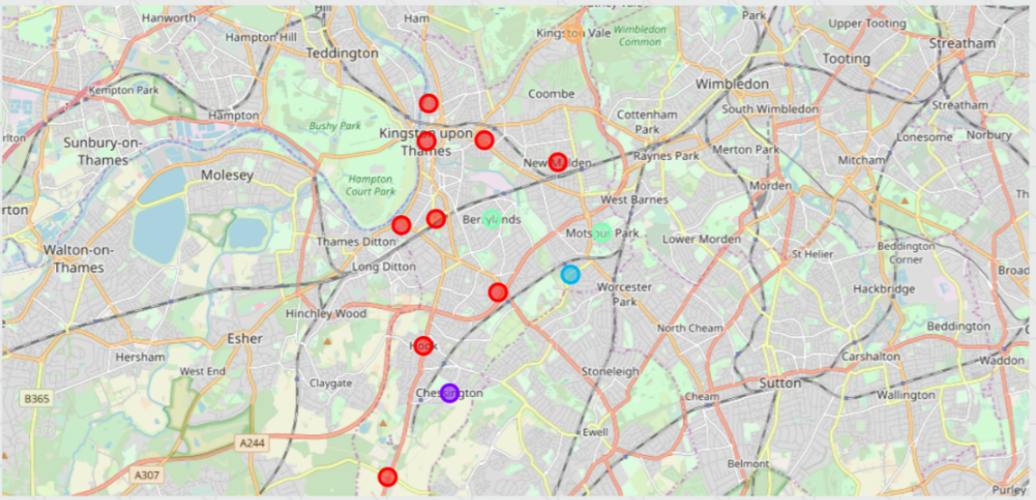
Results
After running the K-Means clustering we can access each cluster created to see which neighbourhoods were assigned to each of the five cluster. Visualing the clustered neighbourhoods on a map using the folium library.
Each cluster is colour coded for each of presentation , we can see that majority of the neighbourhood fall in the red cluster which is the first cluster. Three neighbourhood have their own cluster (Blue, yellow and Purple), these are cluster two three and five. The green cluster consist of two neighbourhoods which is the 4Th cluster.

Slide 11
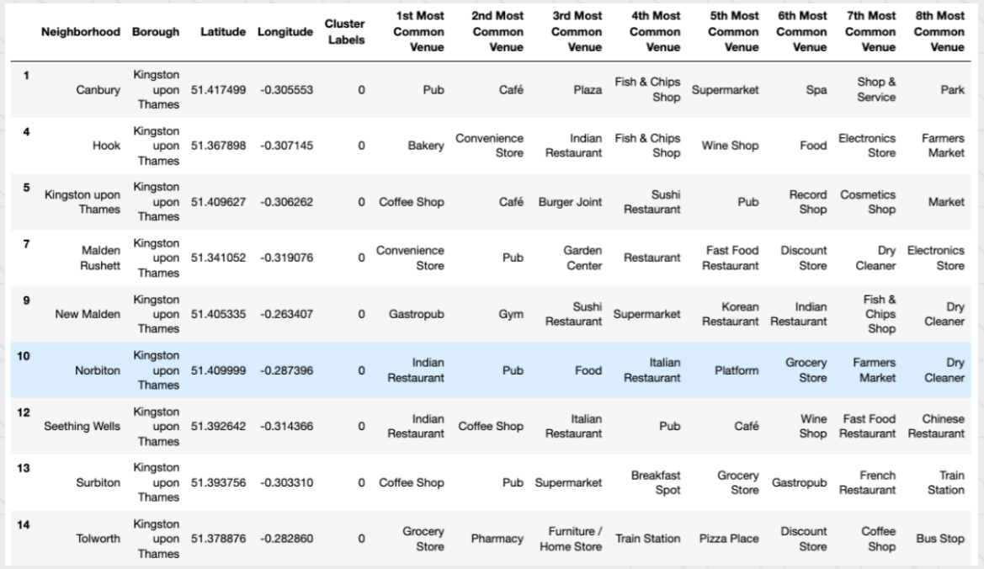
Looking into the neighbourhoods in the first cluster.
The cluster is the biggest cluster with 9 of the 15 neighbourhoods in the borough Kington upon Thames. Upon closely examining the neighbourhoods we can see that the most common venues in these neighbourhood are Restaurants , Pubs , Supermarket and stores.

Slide 12
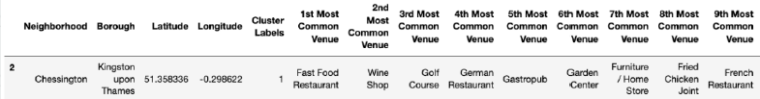
Looking into the neighbourhood in the second cluster
The second cluster as one neighbour which consist of venues such as restaurant , Golf courses and wine shops.

Slide 13
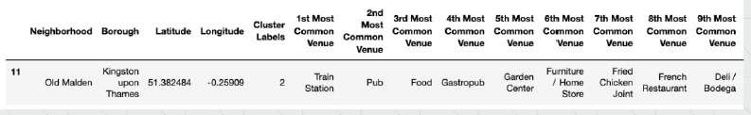
Looking into the neighbourhoods in the third cluster
The third cluster has one neighbourhoods which consist of venues such as Train station, Restaurant and Furniture shops.

Slide 14
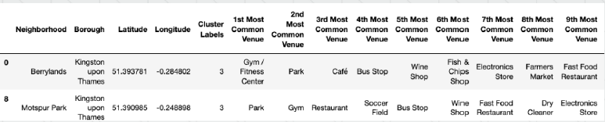
Looking into the neighbourhoods in the fourth cluster
The fourth cluster has two neighbourhoods in it, these neighbourhoods have common venues such as park , gym , bus stop Restaurant , electronic shops and soccer fields.

Slide 15
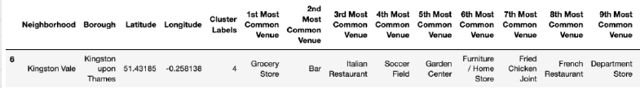
Looking into the neighbourhoods in the fifth cluster
The fifth cluster has one neighbourhood consist of venues such as Grocery shops, Bars , Restaurant , Furniture shops and Departments shops.

Slide 16
Discussion
The aim of this project is to help people who want to relocate to the safest borough in London, expats can chose the neighbourhoods to which they want to relocate based on the most common venues in it.
For example is a person is looking for neighbourhood with good connectivity and public transportation we can see that cluster 3 and 4 have Train stations and Bus stops as the most common venues.
If a person is looking for a neighbour with stores and restaurants in the close proximity then the neighbourhoods in the first cluster is suitable.
For a family I feel that the neighbourhood in cluster 4 are most suitable dues to the common venues in that cluster , these neighbourhoods have common venues such as Park , Gym , Bus Stops , Restaurant , Electronics Stores and Soccer which is ideal for a family.
The preference of venues may vary from person to person , they can select a neighbourhood based on one priorities .

Slide 17
Conclusion
This project helps a person get a better understanding of the neighbourhoods with respect to the most common venues in that neighbourhood. It is always helpful to make use of technology to stay one step ahead i.e. finding out more about the places before moving into neighbourhood.
We have just taken safety as a primary concern to shortlist the safest borough of London . The future of this project includes taking other factors such as cost of living in the area into consideration to shortlist the borough , such as filtering areas based on predefined budget.

